Slide 1
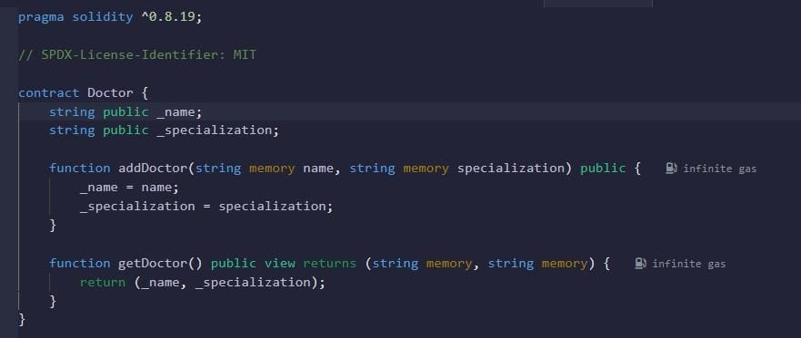
DOCTOR.SOL

Slide 2
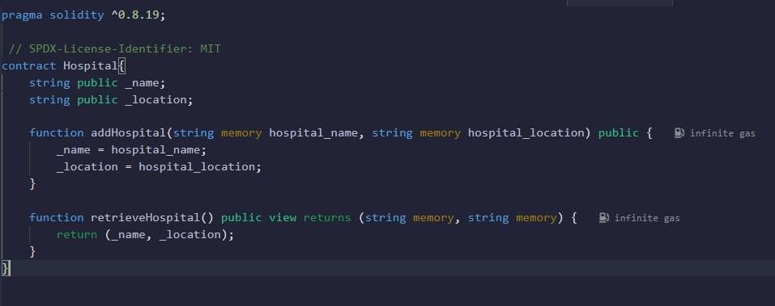
HOSPITAL.SOL

Slide 3
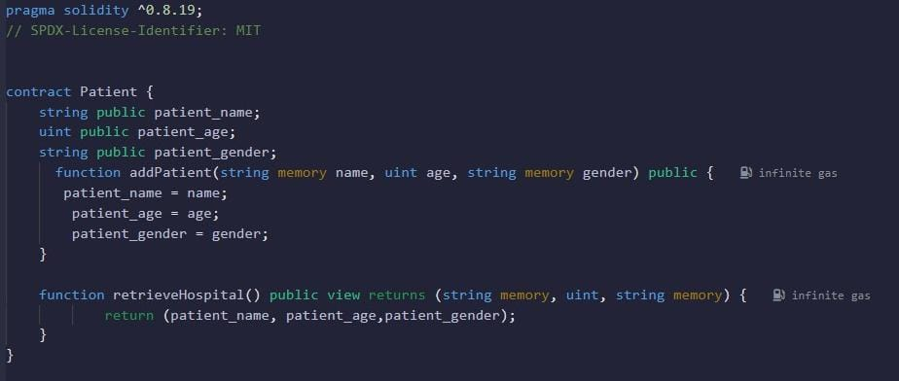
PATIENT.SOL

Slide 4
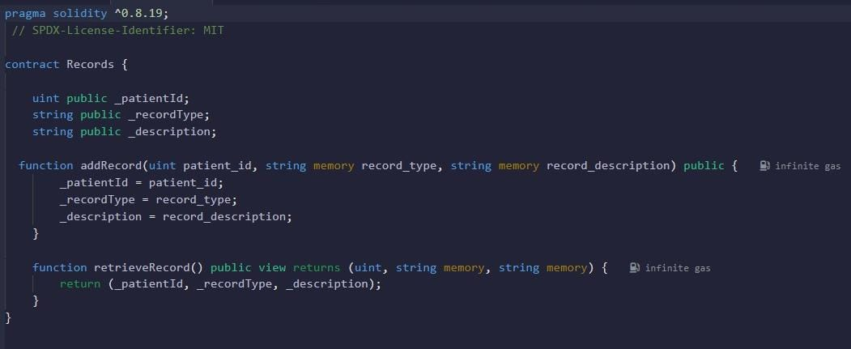
RECORD.SOL

Slide 5
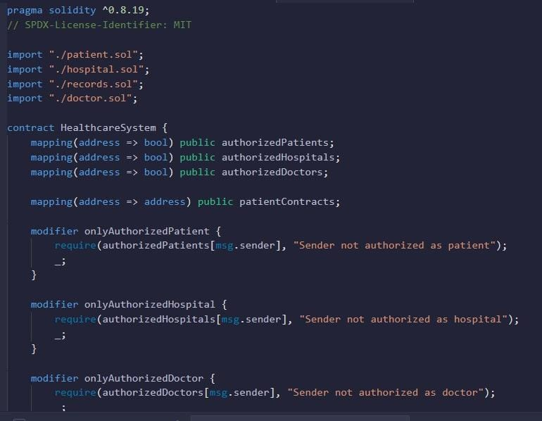
HEALTHCARESYSTEM.SOL

Slide 6
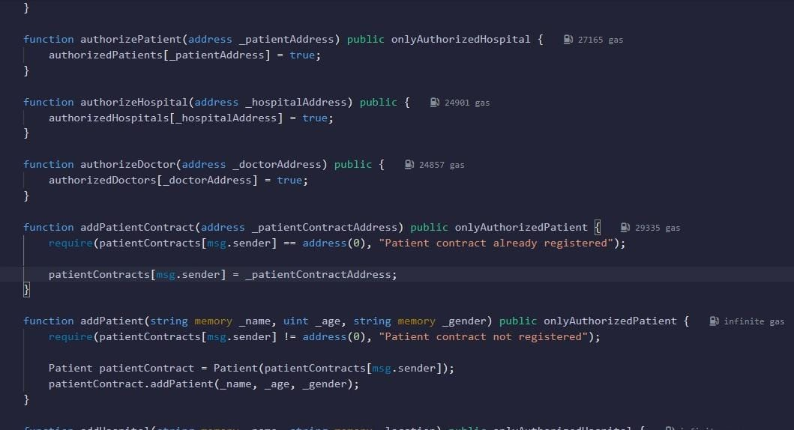

Slide 7
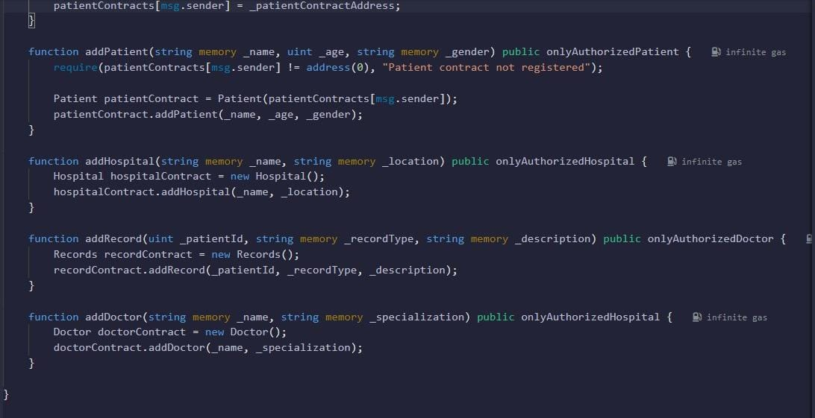

Slide 8
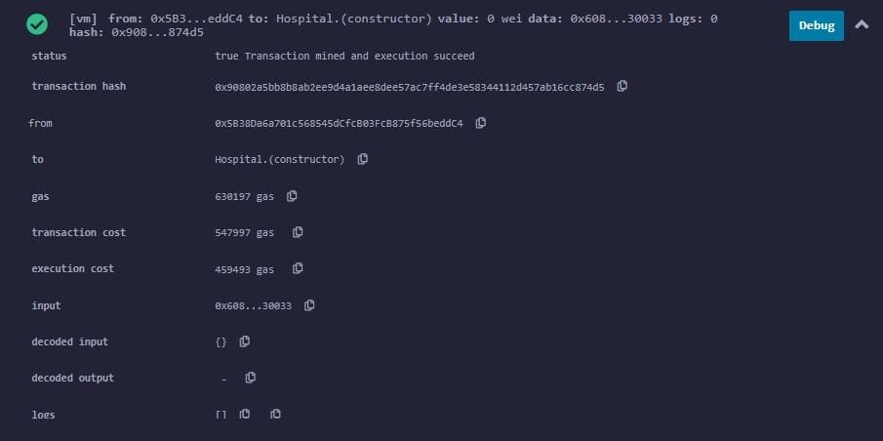
HOSPITAL TRANSACTION

Slide 9
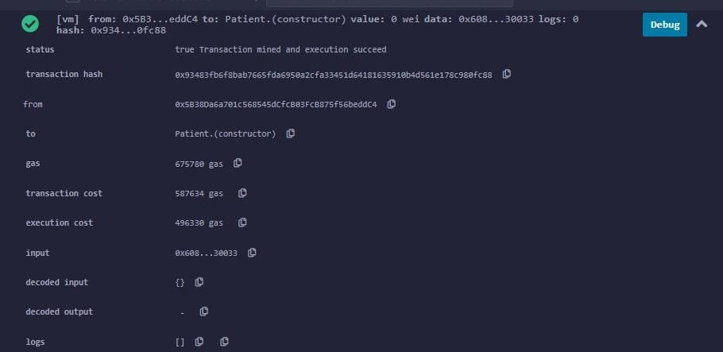
PATIENT TRANSACTION

Slide 10
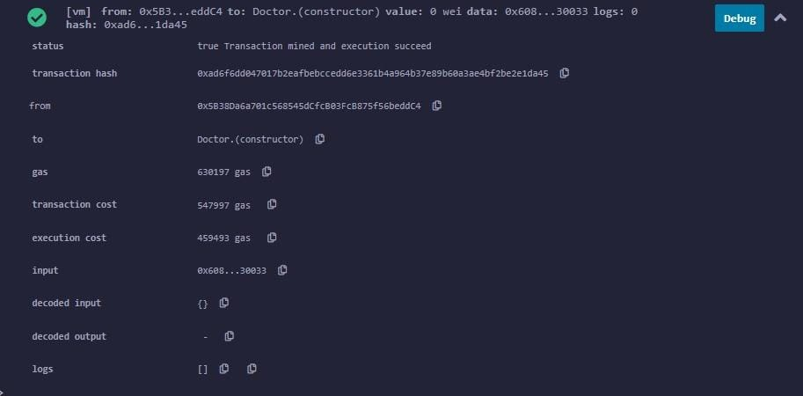
DOCTOR TRANSACTION

Slide 11
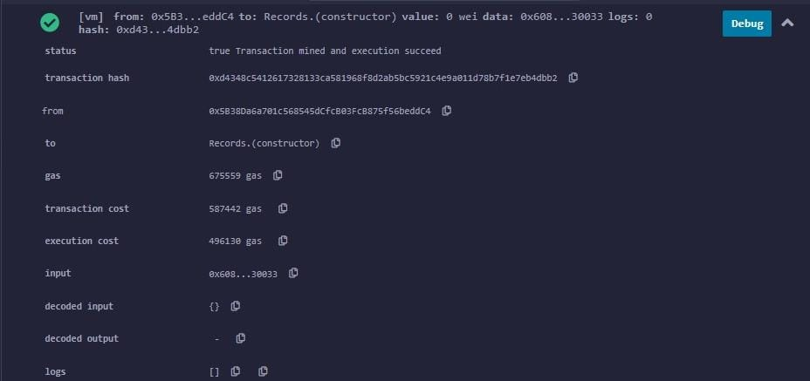
RECORD TRANSACTION

Slide 12
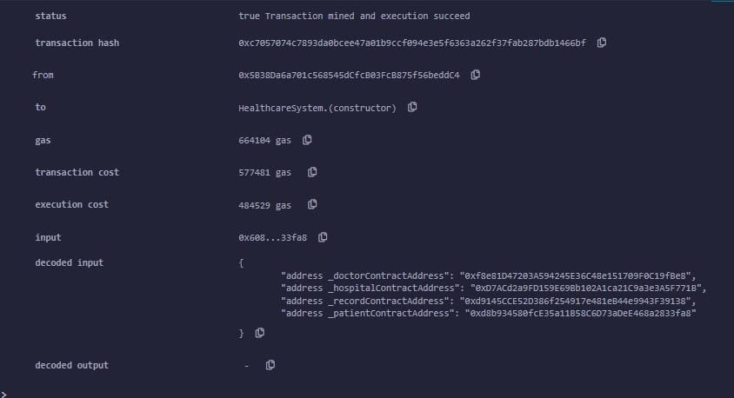
HEALTHCARESYSTEM TRANSACTION

